Slide 1


Spatial scale in crime location choice research
Wim Bernasco, NSCR / VU & K Kuralarasan, Ghent University
Department of Criminology, Criminal Law and Social Law
  Institute for International Research on Criminal Policy

Slide 2
  What is crime location choice?
Prelude
Literature
  How did prior studies deal with spatial scale?
Theory
  What does choice theory say about spatial scale?
Analysis
  How should we deal with spatial scale?
5
Notes:
5

Slide 3
What is crime location choice?
Question: What makes offenders chose a crime location?
Answer: Attributes of potential locations and offenders
Idiosyncratic features (offender awareness of locations)
Rational choices (utility maximization)
Discrete choice model (conditional logit, or mixed logit)
Disaggregated (individual) data
Locations must be discrete, mutually exclusive and collectively exhaustive
Locations can be any size and shape (street, block, city)
5
Notes:
5

Slide 4
How did prior studies deal with spatial scale?
Literature search
  Ruiter (2017; 17 studies) and Google Scholar search
  Quantitative empirical studies using discrete choice framework
  Result: 33 crime location choice studies (some use same data)
Code
  Label of spatial unit (e.g., street segment, neighbourhood)
  Average size of spatial unit
  Number of spatial units
  Number of crimes
5
Notes:
5

Slide 5
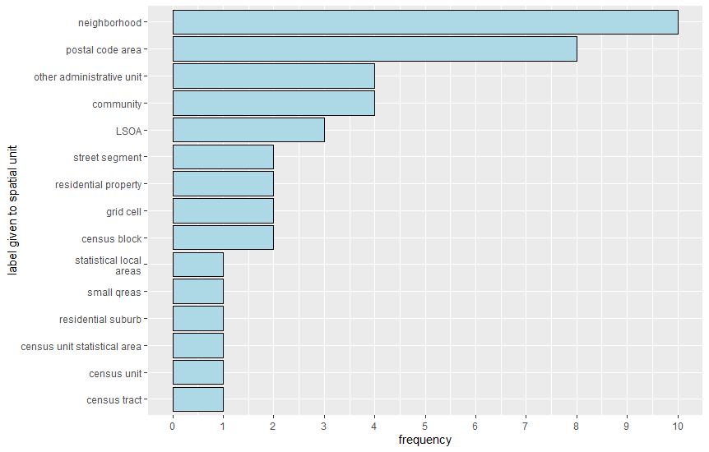
How have spatial units been labelled?
5
Notes:
5

Slide 6
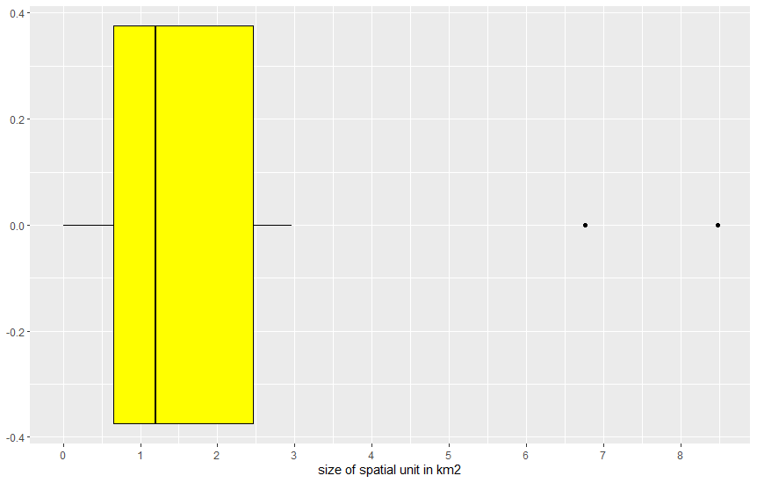
What were sizes of spatial units*?
*Note: No size details in 12 of the 43 studies
5
Notes:
5

Slide 7
MAUP in crime location choice?
Potentially yes!
No studies checked for MAUP (all conducted single-scale analysis)
MAUP is a theoretical issue
5
Notes:
5

Slide 8
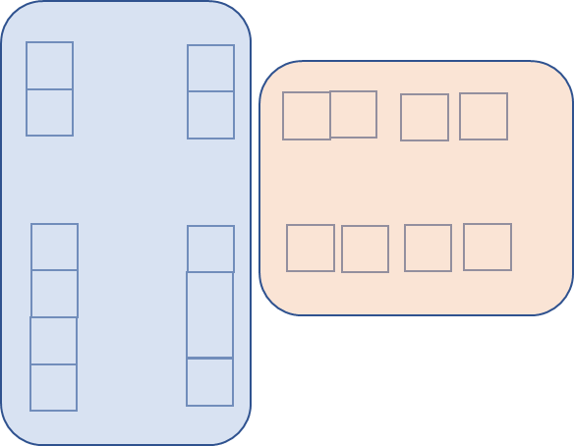
Theory: main assumption
Offenders choose elemental spatial alternatives
Researchers aggregate spatial alternatives
5
Notes:
5

Slide 9
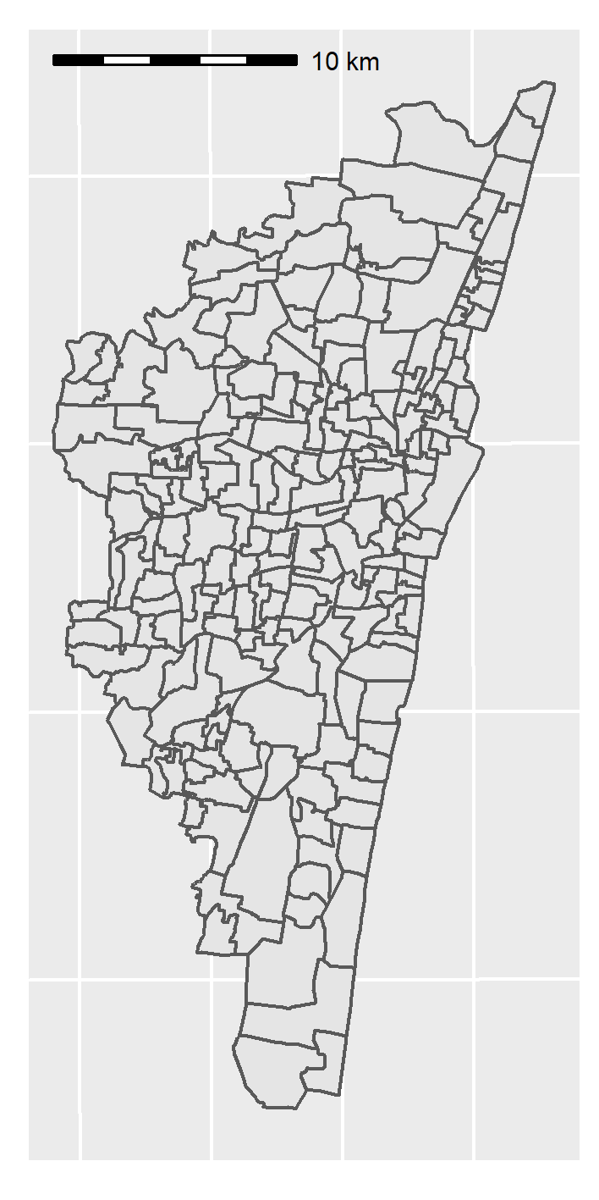
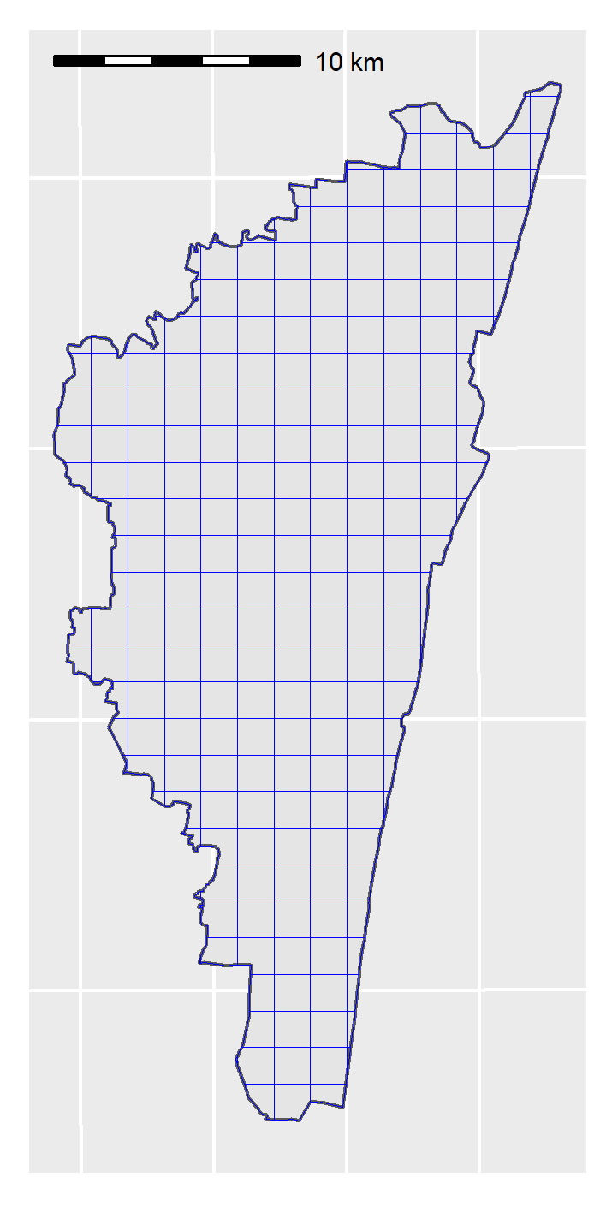
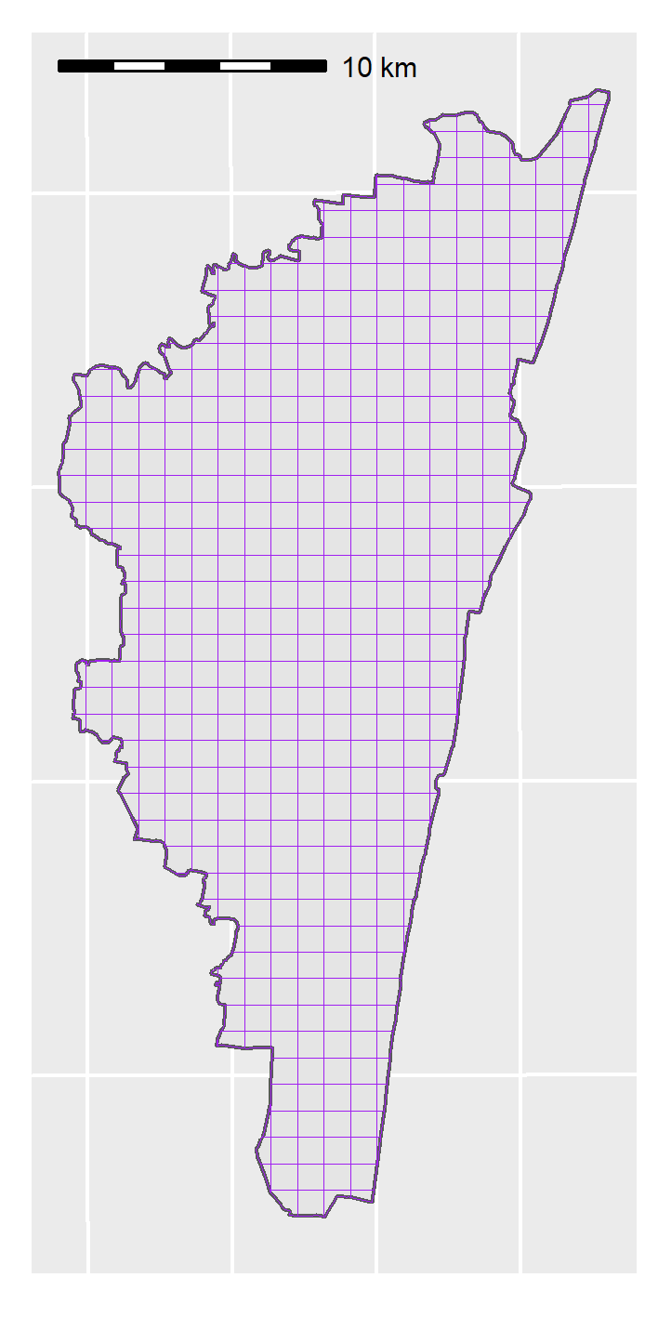
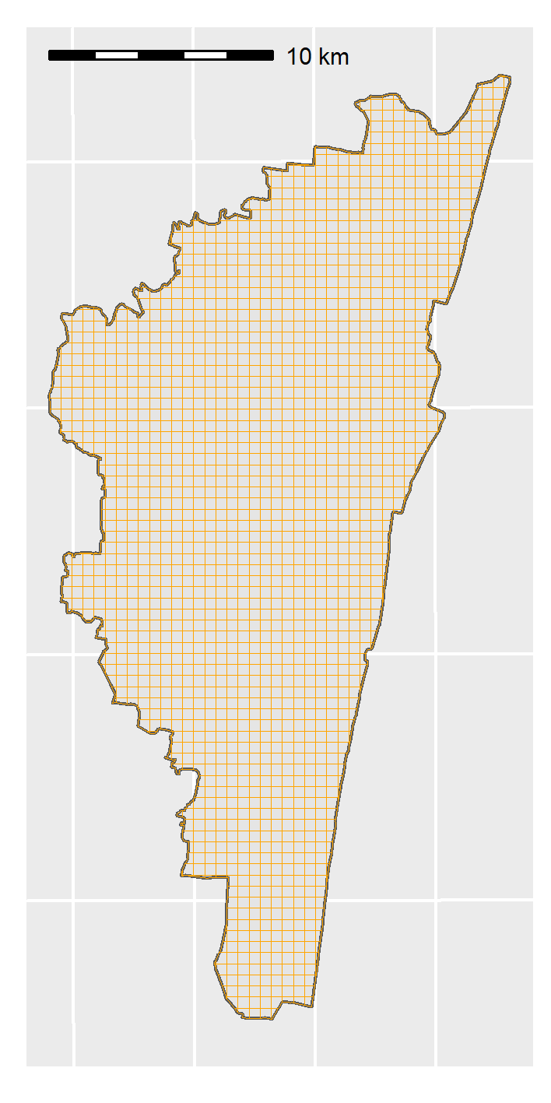
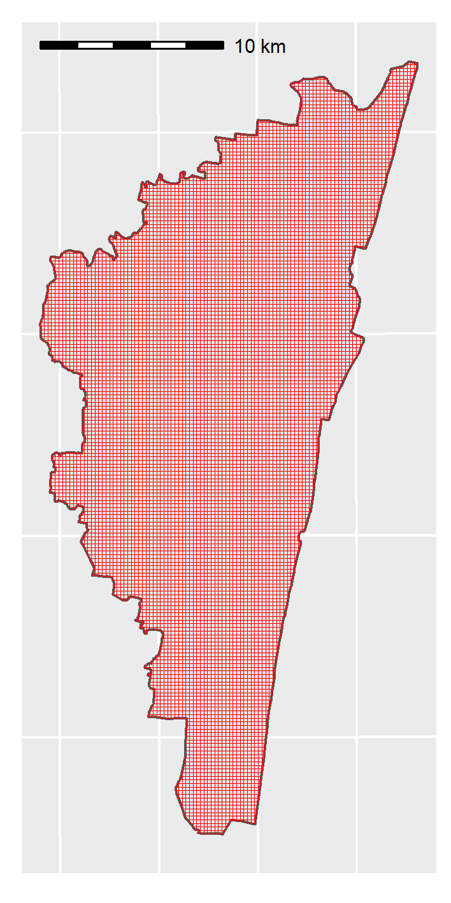
Wards and four alternative grid sizes
Chennai wards
1500m × 1500m
1000m × 1000m
500m × 500m
200m × 200m
Ward geometry
5
Notes:
5

Slide 10
Wards and four alternative grid sizes
Chennai wards
1500m × 1500m
1000m × 1000m
500m × 500m
200m × 200m
Computational nightmare
5
Notes:
5

Slide 11
5
Notes:
5

